Slide 1
Data and Web Application CC6012
Sandra Fernando

Slide 2
Content
Model
View
Controller
Routing
Model Binding
Dependency Injection
Filters
DBCotext
SQLite
CRUD
Getting started with MVC

Slide 3
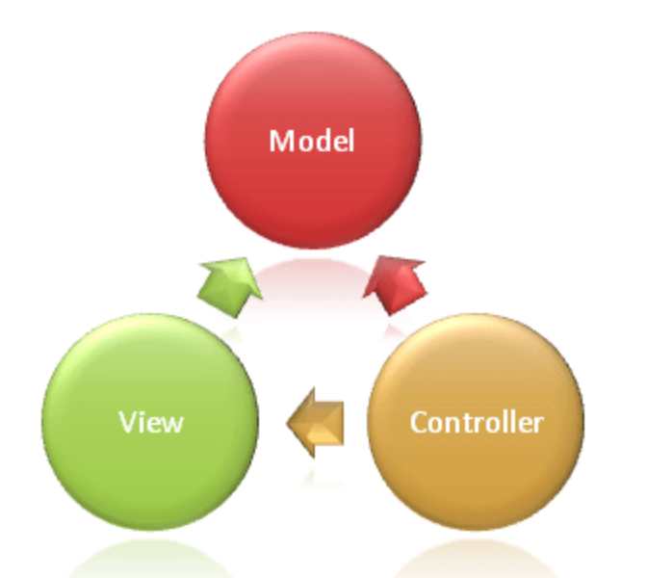
M-V-C
The Model-View-Controller (MVC) architectural pattern separates an application into three main groups of components: Models, Views, and Controllers. This pattern helps to achieve seperation. Using this pattern, user requests are routed to a Controller which is responsible for working with the Model to perform user actions and/or retrieve results of queries. The Controller chooses the View to display to the user, and provides it with any Model data it requires.

Slide 4
Model Responsibilities
The Model in an MVC application represents the state of the application and any business logic or operations that should be performed by it. Business logic should be encapsulated in the model, along with any implementation logic for persisting the state of the application. Strongly-typed views typically use ViewModel types designed to contain the data to display on that view. The controller creates and populates these ViewModel instances from the model.

Slide 5
View Responsibilities
Views are responsible for presenting content through the user interface. They use the Razor view pages to embed .NET code in HTML markup. There should be minimal logic within views, and any logic in them should relate to presenting content. If you find the need to perform a great deal of logic in view files in order to display data from a complex model, one can use using view componets, ViewModel, or view template to simplify the view.
Razor page is a compact, expressive and fluid template markup language for defining views using embedded C# code. Razor is used to dynamically generate web content on the server. You can cleanly mix server code with client side content and code.

Slide 6
Controller Responsibilities
Controllers are the components that handle user interaction, work with the model, and ultimately select a view to render. In an MVC application, the view only displays information; the controller handles and responds to user input and interaction. In the MVC pattern, the controller is the initial entry point, and is responsible for selecting which model types to work with and which view to render (hence its name - it controls how the app responds to a given request).

Slide 7
Routing
ASP.NET Core MVC is built on top of ASP.NET core Routing, a powerful URL-mapping component that lets you build applications that have comprehensible and searchable URLs. This enables you to define your application's URL naming patterns that work well for search engine optimization (SEO) and for link generation, without regard for how the files on your web server are organized. You can define your routes using a convenient route template syntax that supports route value constraints, defaults and optional values.

Slide 8
Model binding
ASP.NET Core MVC model binding converts client request data (form values, route data, query string parameters, HTTP headers) into objects that the controller can handle. As a result, your controller logic doesn't have to do the work of figuring out the incoming request data; it simply has the data as parameters to its action methods.
public async Task<IActionResult> Login(LoginViewModel model, string returnUrl = null) { ... }

Slide 9
Dependency injection
A dependency is an object that another object depends on.
n a large project with multiple classes depending on the base class, the configuration code becomes scattered across the app.
Injection of the service into the constructor of the class where it's used. The framework takes on the responsibility of creating an instance of the dependency and disposing of it when it's no longer needed.

Slide 10
Filters
Filters help developers encapsulate cross-cutting concerns, like exception handling or authorization. Filters enable running custom pre- and post-processing logic for action methods, and can be configured to run at certain points within the execution pipeline for a given request. Filters can be applied to controllers or actions as attributes (or can be run globally). Several filters (such as Authorize) are included in the framework. [Authorize] is the attribute that is used to create MVC authorization filters.
[Authorize]
public class AccountController : Controller

Slide 11
ApplicationDbContext
ApplicationDbContext is a class in ASP.NET applications that inherits from DbContext, which is a part of the Entity Framework. Entity Framework is an Object-Relational Mapping (ORM) framework that simplifies database interactions by allowing developers to work with databases using object-oriented principles instead of writing raw SQL queries.
In the context of ASP.NET applications, specifically those that use Entity Framework for data access, the ApplicationDbContext class serves as the primary point of interaction between the application's code and the underlying database. It is responsible for representing the database schema as a set of .NET classes and allows developers to perform CRUD (Create, Read, Update, Delete) operations on the database using C# or other .NET languages.

Slide 12
SQLite
SQLite is a database engine written in the C programming language. It is not a standalone app; rather, it is a library that software developers embed in their apps. As such, it belongs to the family of embedded databases

Slide 13
Scaffold CRUD operations
Scaffolding is a technique used by many MVC frameworks like ASP.NET MVC, Ruby on Rails, Cake PHP and Node. JS etc., to generate code for basic CRUD (create, read, update, and delete) operations against your database effectively. Further you can edit or customize this auto generated code according to your need
Scaffolding consists of page templates, entity page templates, field page templates, and filter templates. These templates are called Scaffold templates and allow you to quickly build a functional data-driven Website.
Scaffold templates are used to generate code for basic CRUD operations within your ASP.NET MVC applications against your database with the help Entity Framework. These templates use the Visual Studio T4 templating system to generate views for basic CRUD operations with the help of Entity Framework.

Slide 14
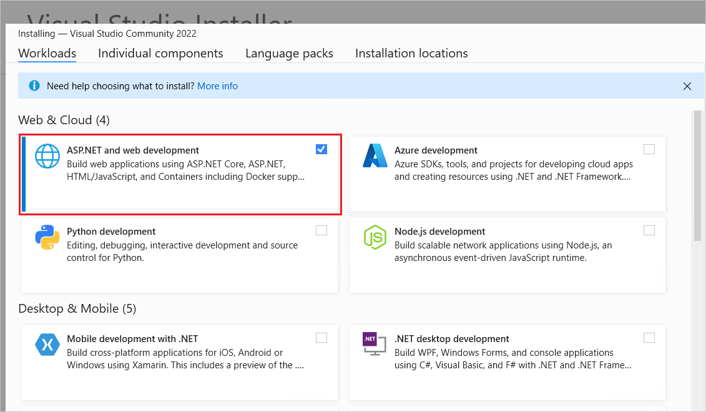
Get started with ASP.NET Core MVC
Prerequisites:
Visual Studio 2022

Slide 15
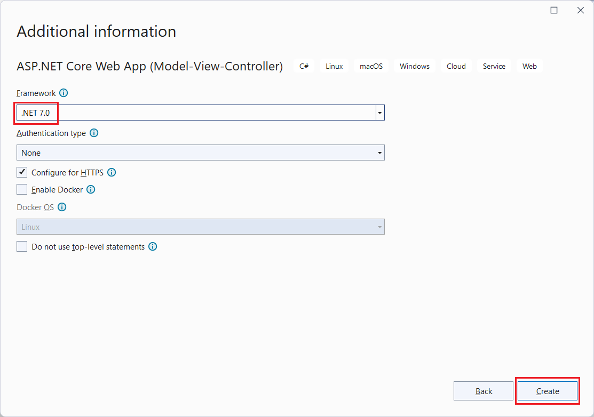

Create a web app
Start Visual Studio and select Create a new project.
In the Create a new project dialog, select ASP.NET Core Web App (Model-View-Controller) > Next.
Select Individual authentication

Slide 16
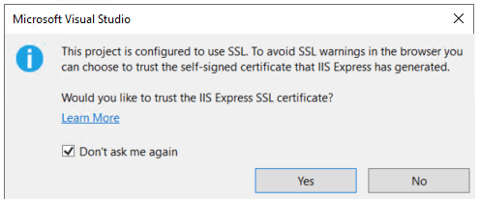
Run the app
Select Ctrl+F5 to run the app without the debugger.
Visual Studio displays the following dialog when a project is not yet configured to use SSL: Select Yes if you trust the IIS Express SSL certificate.

Slide 17
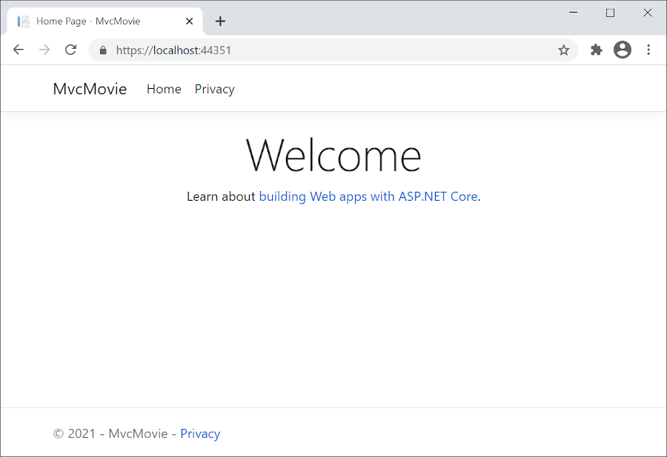
Run the app
You can debug the app by selecting the https button in the toolbar:

Slide 18
Part 2, add a controller to an ASP.NET Core MVC app
The Model-View-Controller (MVC) architectural pattern separates an app into three main components: Model, View, and Controller. The MVC pattern helps you create apps that are more testable and easier to update than traditional monolithic apps.
MVC-based apps contain:
Models: Classes that represent the data of the app. The model classes use validation logic to enforce business rules for that data. Typically, model objects retrieve and store model state in a database. In this tutorial, a Movie model retrieves movie data from a database, provides it to the view or updates it. Updated data is written to a database.
Views: Views are the components that display the app's user interface (UI). Generally, this UI displays the model data.
Controllers: Classes that:
Handle browser requests.
Retrieve model data.
Call view templates that return a response.
In an MVC app, the view only displays information. The controller handles and responds to user input and interaction. For example, the controller handles URL segments and query-string values, and passes these values to the model. The model might use these values to query the database.

Slide 19
Example
https://localhost:5001/Home/Privacy: specifies the Home controller and the Privacy action.
https://localhost:5001/Movies/Edit/5: is a request to edit the movie with ID=5 using the Movies controller and the Edit action, which are detailed later in the tutorial.

Slide 20
MVC architectural pattern
The MVC architectural pattern separates an app into three main groups of components: Models, Views, and Controllers. This pattern helps to achieve separation of concerns: The UI logic belongs in the view. Input logic belongs in the controller. Business logic belongs in the model. This separation helps manage complexity when building an app, because it enables work on one aspect of the implementation at a time without impacting the code of another. For example, you can work on the view code without depending on the business logic code.

Slide 21
Class Demo (part 1-3)

Slide 22
Download Link
Free Community Edition VS2022 for Web Application
https://visualstudio.microsoft.com/vs/community/

Slide 23
Tutorial Activity
Login to VM 6012 and check if Visual Studio is working
Complete part 1 -3 in the book ‘Get started with ASP.NET Core MVC

Slide 24
Reference
Recommended Reading:
Microsoft - https://learn.microsoft.com/en-us/aspnet/core/introduction-to-aspnet-core?view=aspnetcore-7.0

Slide 25
Thank you for Listening…

